Slide 1

PBR VISVODAYA INSTITUTE OF TECHNOLOGY AND SCIENCE (AUTONOMOUS), KAVALI
TECHNICAL SEMINAR
SPACE COMMUNICATION
AND
SATELLITE TECHNOLOGY
Presented By,
Shaik Khaleel Basha
21731A04B4
Guided By,
Dr. N. Satheesh Kumar

Slide 2
Contents:
Abstract
Introduction
Types of Satellites
Principle of Operation
Working of Satellite Communication
Satellite Orbits in Space
Future Trends in Space Communication
Applications of Satellite Technology
Drawbacks
Conclusion
References

Slide 3
Abstract
Space communication and satellite technology have played a crucial role in shaping the modern world by enabling seamless global communication, data transfer, and satellite-based services.
These technologies rely on artificial satellites placed in Earth’s orbit to transmit and receive signals,
facilitating a wide range of applications, from television broadcasting and internet access to scientific research and military communication.

Slide 4
Introduction to Satellite Communication
Satellite communication enables long-distance communication.
Relies on artificial satellites in Earth’s orbit.
Revolutionized global communication by overcoming geographical barriers.
Applications span telecommunications, navigation, broadcasting, and emergency response.

Slide 5
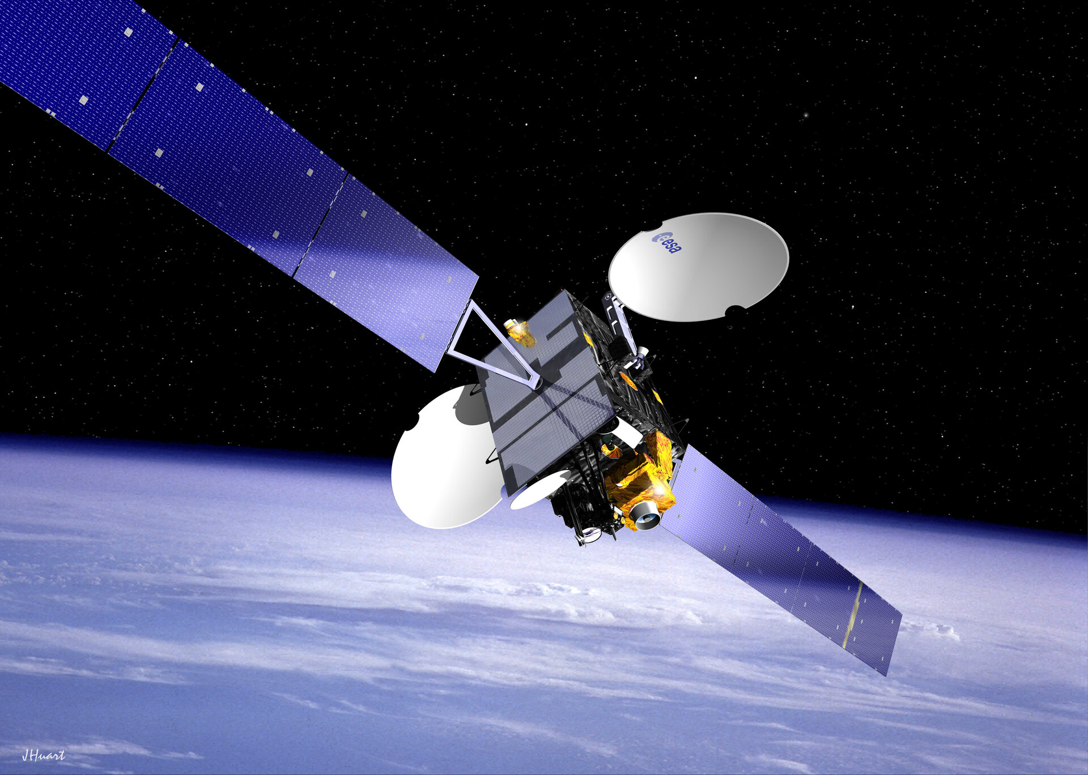
Types of Satellites:
Communication Satellites: Enable TV, internet, and phone services.
Navigation Satellites: Provide GPS and location services.
Weather Satellites: Monitor climate and weather patterns.
Scientific Satellites: Conduct space research and observations.

Slide 6
Principle of Operation
Satellites act as relay stations in space.
Signals transmitted from Earth stations to satellites.
Satellites amplify and retransmit signals to designated ground stations.
Electromagnetic waves (radio/microwave) facilitate data transfer.

Slide 7
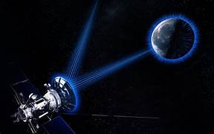
Working of Satellite Communication
Uplink (Transmission from Earth to Satellite)
Signal generated at Earth station.
Modulation of data onto carrier frequency.
High-powered antennas send the signal toward the satellite.
Signal travels through atmosphere and space.

Slide 8
Reception by Satellite
Satellite’s antenna receives the uplink signal.
Signal filtered and frequency-converted.
Transponder amplifies and prepares the signal for retransmission.

Slide 9
Signal Amplification and Processing
Amplification ensures signal strength.
Traveling-wave tube (TWT) amplifies the signal.
Signal processed and demodulated to extract data.
Error correction techniques applied if necessary.

Slide 10
Downlink (Transmission from Satellite to Earth)
Signal frequency conversion for downlink.
Transmission from satellite to Earth station.
Signal travels back through space to Earth.
Transmission uses a focused beam for precise delivery.

Slide 11
Reception on Earth (Downlink Reception)
Ground station’s antenna receives the downlink signal.
Signal demodulated to extract data.
Data decoded and converted to usable format.
Distributed or routed to users (e.g., TV, internet).

Slide 12
Communication Relays (Cross-Link Satellites)
Satellites may communicate with each other in a network.
Cross-link satellites pass data to other satellites instead of directly to Earth.
Beneficial for global coverage and low-latency communications.

Slide 13
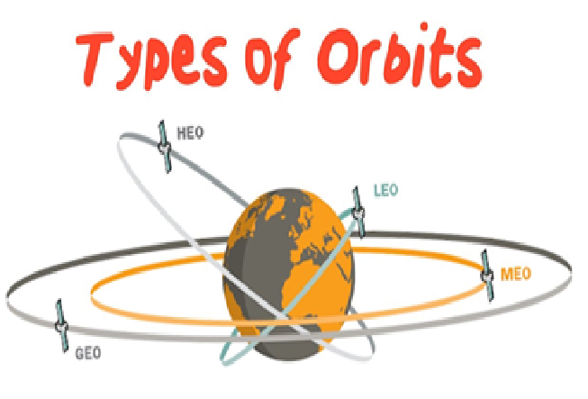
Satellite Orbits in Space
Types of Orbits:
Low Earth Orbit (LEO): 160–2,000 km altitude (e.g., Starlink satellites).
Medium Earth Orbit (MEO): 2,000–35,000 km altitude (e.g., GPS satellites).
Geostationary Orbit (GEO): 35,786 km altitude (e.g., communication satellites).
Polar Orbit: Passes over Earth's poles (e.g., weather satellites).

Slide 14
Future Trends in Space Communication
Laser Communication:
Faster data rates for deep space missions.
Quantum Communication:
Secure communication using quantum entanglement.
Interplanetary Internet:
Developing protocols for communication across the solar system.
Small Satellites (CubeSats):
Low-cost, miniaturized satellites for research and communication.

Slide 15
Applications of Satellite Communication
Telecommunications: Mobile phone networks, internet services.
Broadcasting: TV, radio broadcasting.
Navigation: GPS systems for global positioning.
Earth Observation: Monitoring climate, weather, and environmental changes.
Military and Defense: Secure communications, surveillance, and reconnaissance.

Slide 16
Drawbacks of Satellite Communication
High launch and maintenance costs.
Signal latency, especially for GEO satellites.
Limited bandwidth in some satellite systems.
Vulnerability to interference from weather, space debris, and solar flares.

Slide 17
Conclusion
Satellite communication has revolutionized long-distance communication.
Continuous advancements in technology promise enhanced global coverage.
Despite challenges, satellite communication remains essential for global connectivity.
Future innovations, such as LEO constellations, hold promise for even greater performance and cost-effectiveness.

Slide 18
References
Books, Articles, and Websites:
NASA's official website.
European Space Agency (ESA) resources.
Scientific journals on space communication.

